Slide 1
Design Analysis and Algorithm Binary Search

Slide 2
Introduction
Binary Search is a search algorithm that find the position of a target value within a sorted array.
Binary search is also known as half interval search or algorithm search.
Binary search algorithm works on the principle of Divide conquer.
Binary Search can be implemented on only sorted list of elements.

Slide 3
Divide and conquer
Divide and conquer is the most well know algorithm strategy.
A Divide and conquer algorithm works by recursively breaking down a problem into two or more sub problems of the same or related type until these became simple enough to be solved directly.
The solutions to the sub problems are then combined to give a solution to the original problem.

Slide 4
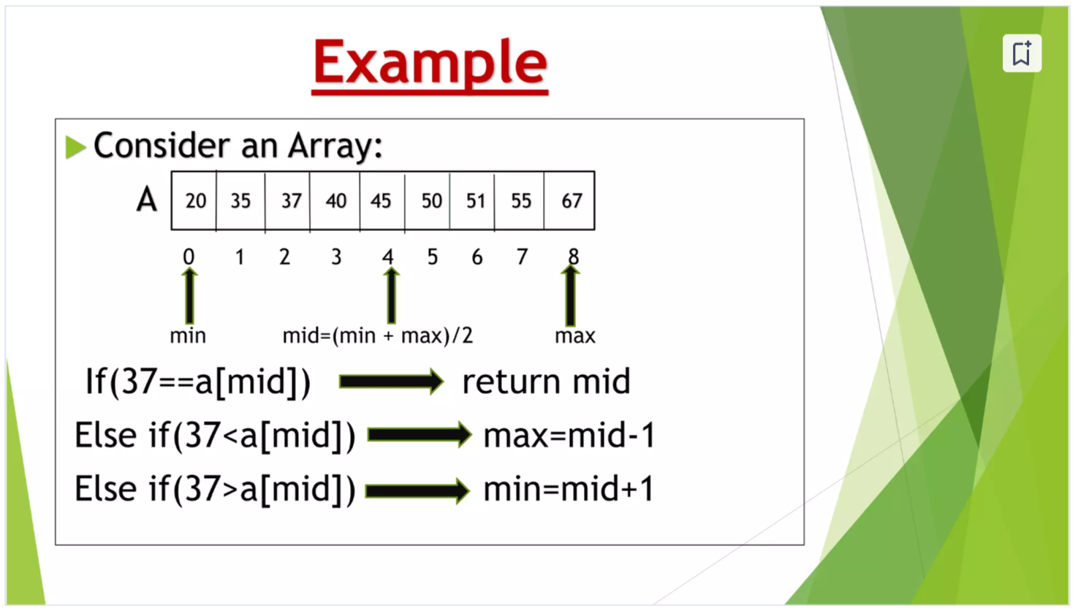

Slide 5
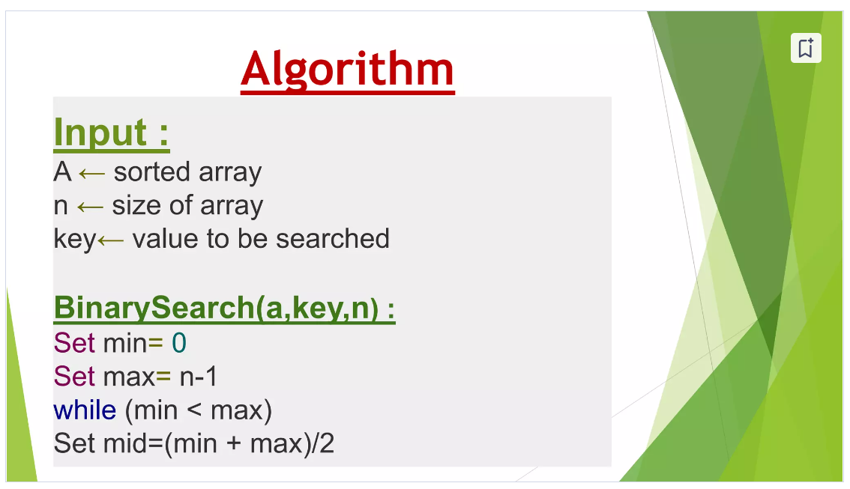

Slide 6
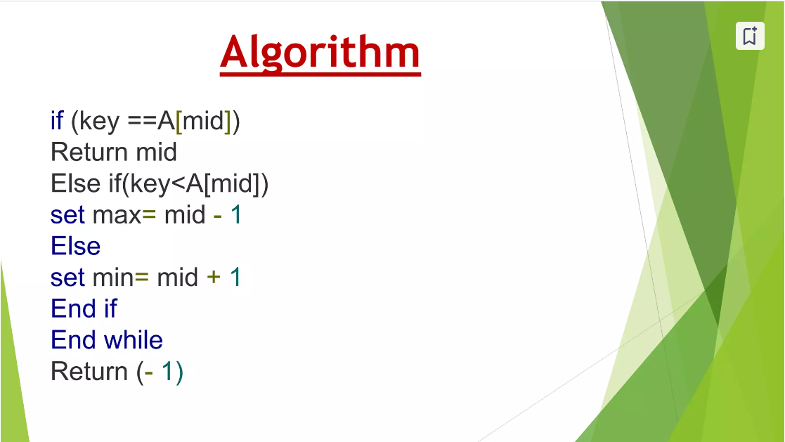

Slide 7
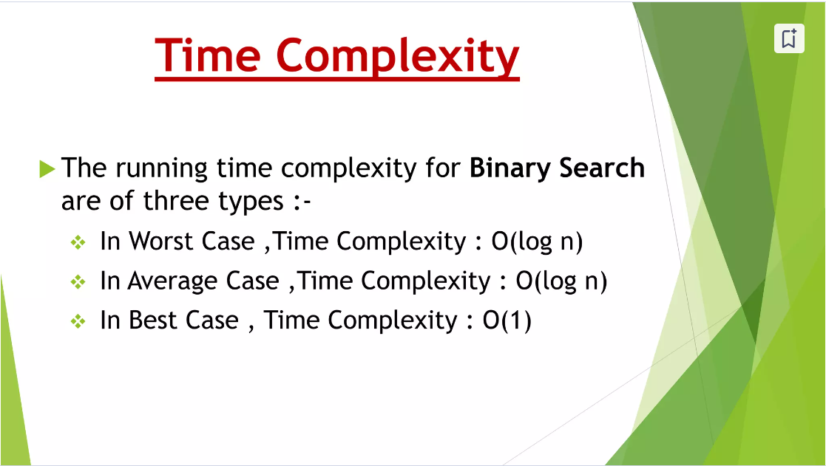

Slide 8
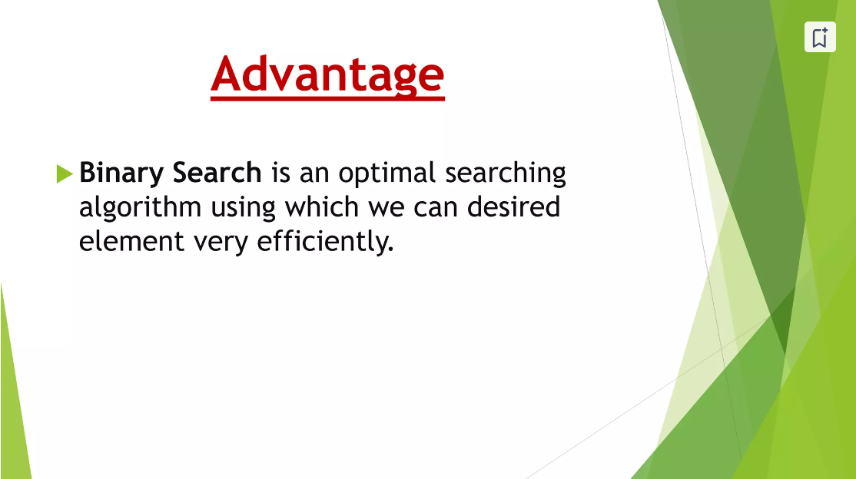

Slide 9
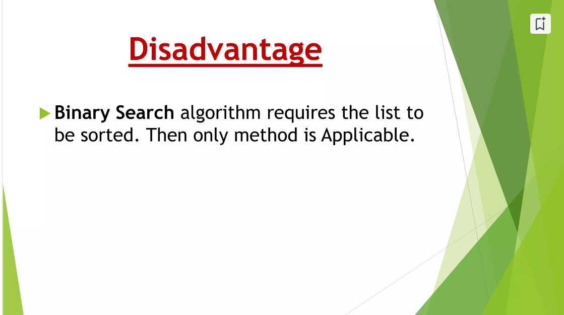

Slide 10
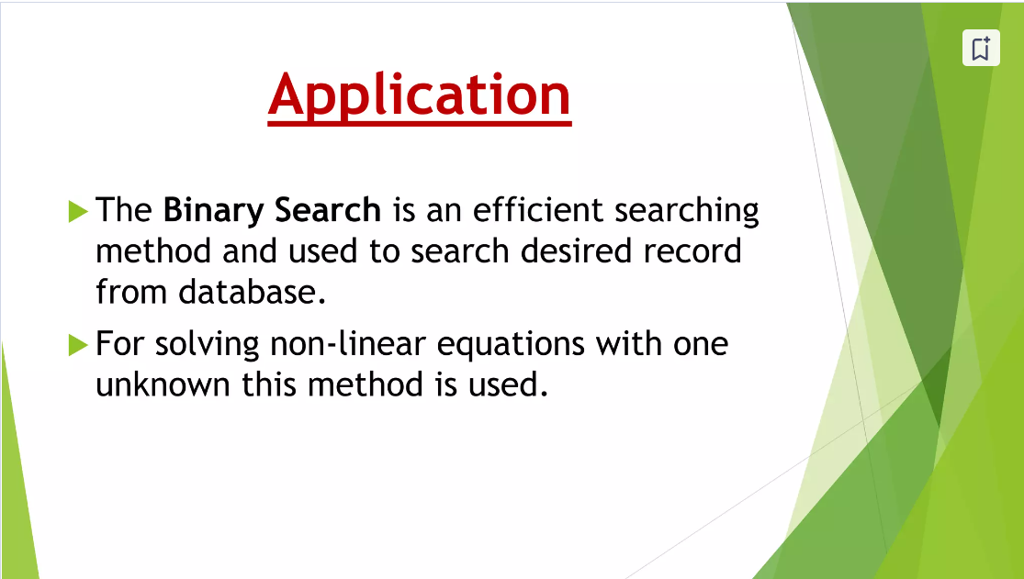

Slide 11


